Slide 1
Operators in C
Rakib Mahmud

Slide 2
Operator & Operand
An operator in C can be defined as the symbol that helps us to perform some specific mathematical, relational, bitwise, conditional, or logical computations on values and variables.
The variable and constants on which the operation tag are known as operand.

Slide 3
Example
c = a + b;
Expression
Operators ( =, + )
Operands (a,b,c)

Slide 4
Types of Operators
Arithmetic operator
Assignment operator
Unary operator
Relational operator
Logical operator
Conditional operator
Bitwise operator
Special operator

Slide 5
Arithmetic Operator
Operator | Description | Example | Result
+ | Do addition | x = 15 + 6 | x = 21
- | Do subtraction | x = 15 - 6 | x = 9
* | Do multiplication | x = 15 * 6 | x = 90
/ | Do division | x = 15 / 6 | x = 2
% | Do modular division | x = 15 % 6 | x = 3

Slide 6
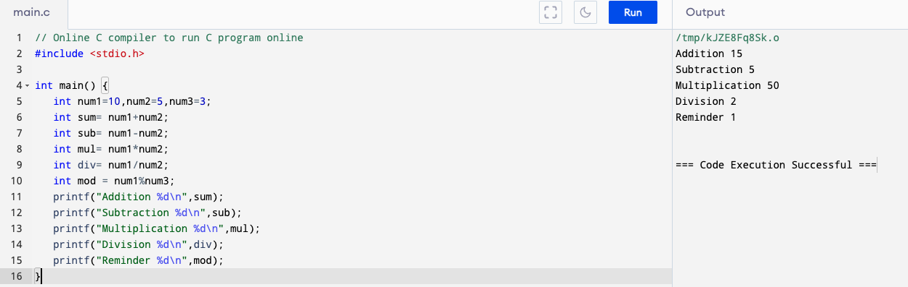
Example

Slide 7
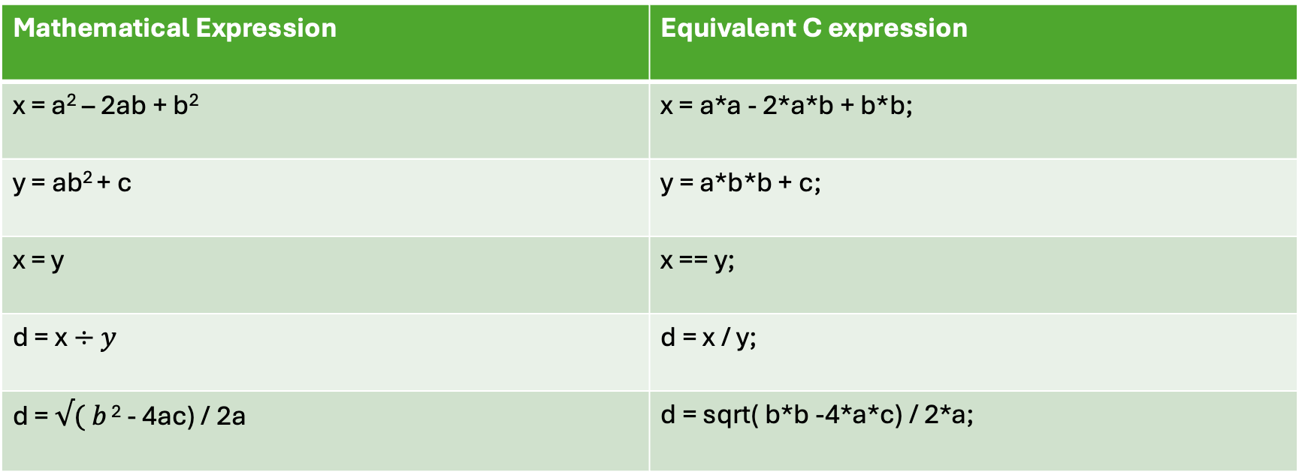
Mathematical formulla to expression
Mathematical Expression | Equivalent C expression
x = a² – 2ab + b² | x = a*a - 2*a*b + b*b;
y = ab² + c | y = a*b*b + c;
x = y | x == y;
d = x$÷y$ | d = x / y;
d = $√( b$ ² - 4ac) / 2a | d = sqrt( b*b -4*a*c) / 2*a;

Slide 8
Precedence and Associativity
Operators | Priority
( ) | 1st
* , / , % | 2nd
+ , - | 3rd
= | 4th

Slide 9
Example
x = 4 / 2 + 8 * 4 – ( 5 +2 ) % 3
= 4 / 2 + 8 * 4 – 7 % 3
= 2 + 8 * 4 – 7 % 3
= 2 + 32 – 7 % 3
= 2 + 32 – 1
= 34 – 1
= 33

Slide 10
Assignment Operator
Assignment operators are used for assigning value to a variable.
Operator | Example | Full Meaning
= | y = x+5
+= | x + = 5 | x = x +5
-= | x - = 5 | x = x - 5
*= | x * = 5 | x = x * 5
/= | x / = 5 | x = x / 5
%= | x % = 5 | x = x % 5

Slide 11
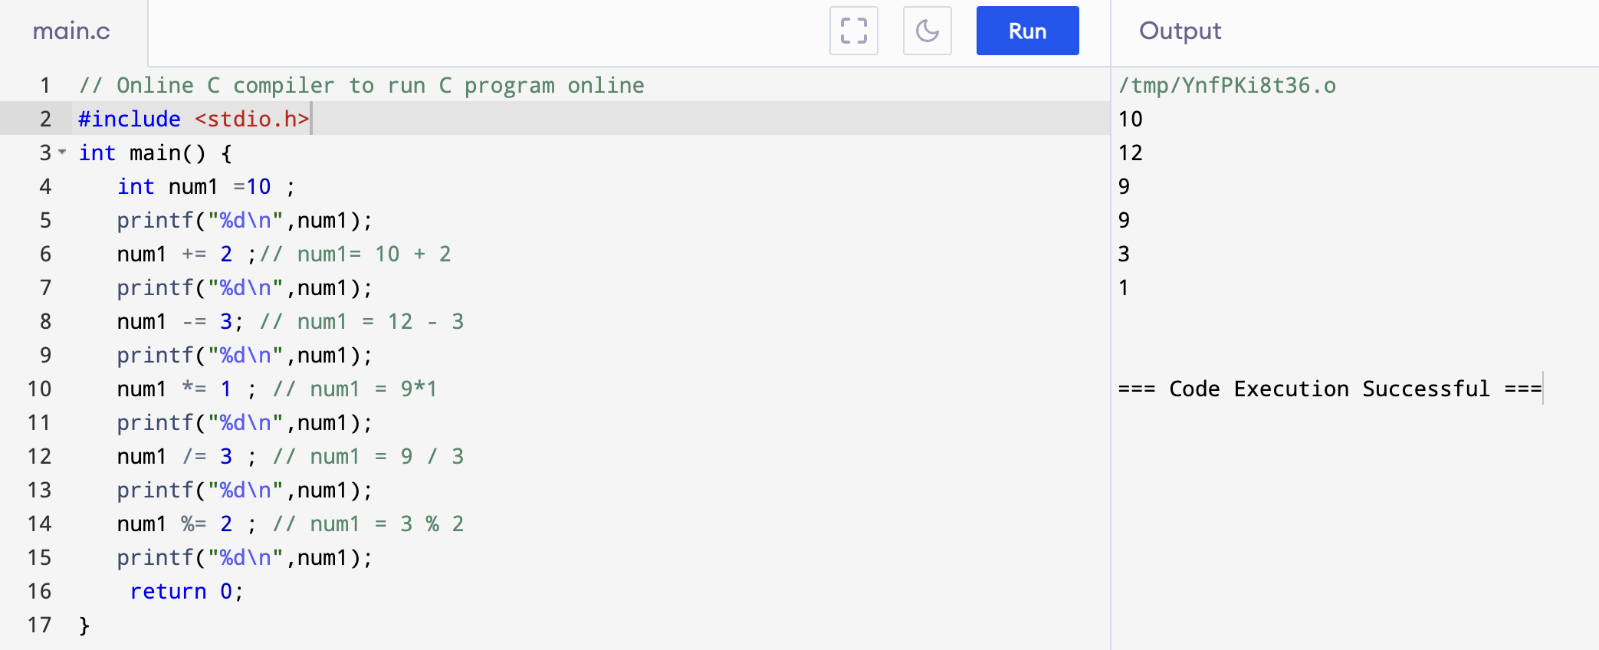
Example

Slide 12
Unary Operator
Unary operators are the operators that perform operations on a single operand to produce a new value.
Unary Opeator | Meaning
+ | Unary plus
- | Unary minus
++ | Increment
-- | Decrement
! | Logical Negation

Slide 13
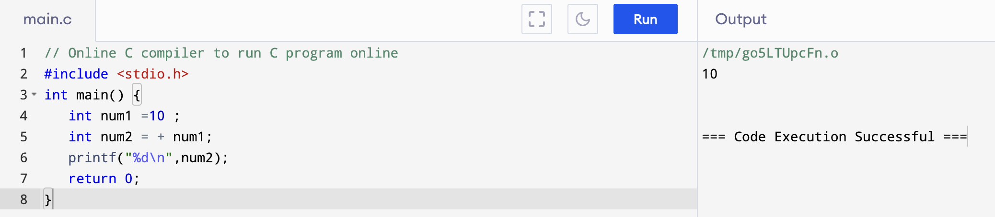
Unary Plus
The unary plus operator is represented as the "+" symbol, and it does not change to the operand value.

Slide 14
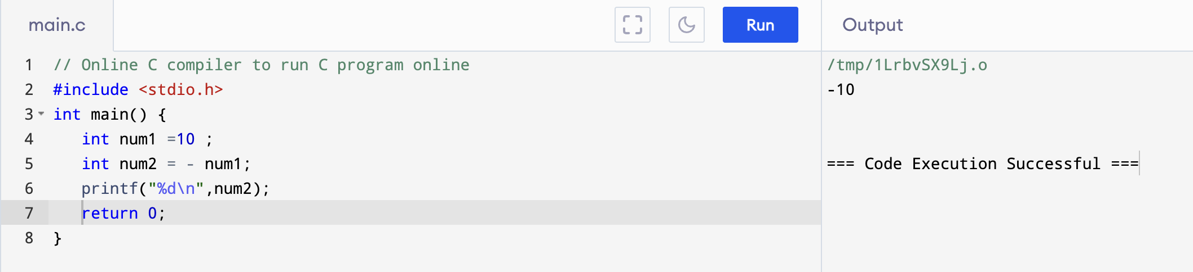
Unary Minus
The minus operator ( – ) changes the sign of its argument. A positive number becomes negative, and a negative number becomes positive.

Slide 15
Increment and Decrement Operator
Increment
Decrement
Prefix Increment
Postfix Increment
Prefix Decrement
Postfix Decrement
++a
a++
--a
a--
Increments a by one
before it is used
Increments a by one
after it is used
Decrements a by one
before it is used
Decrements a by one
after it is used

Slide 16
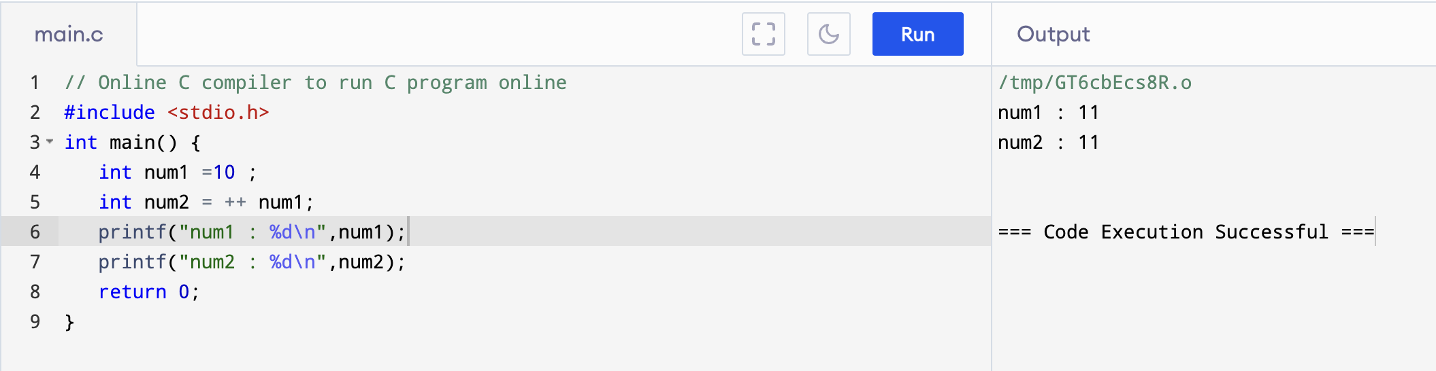
Prefix Increment

Slide 17
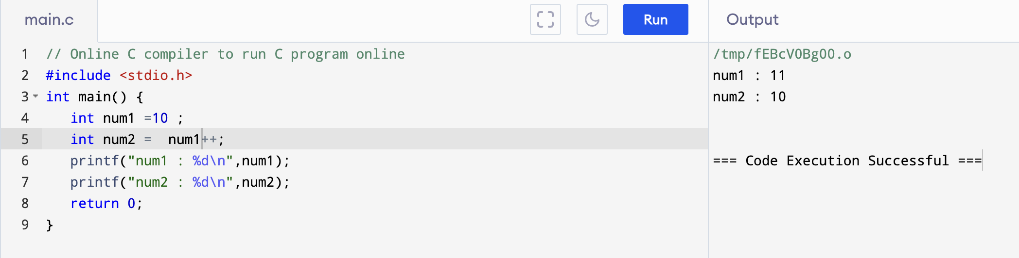
Postfix Increment

Slide 18
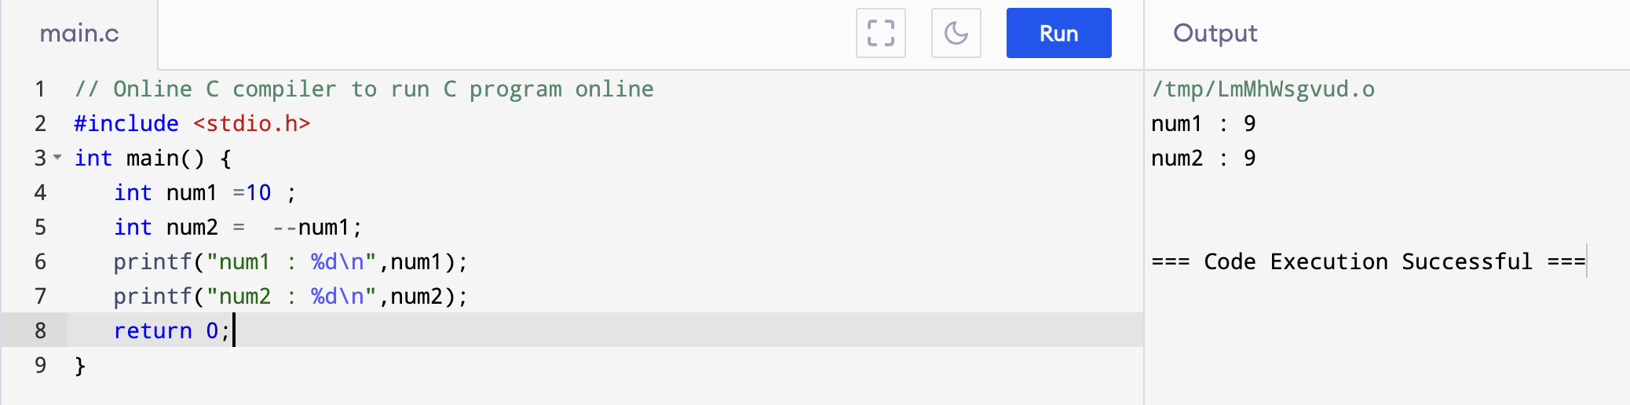
Prefix Decrement

Slide 19
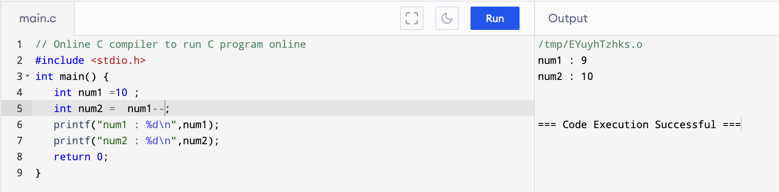
Postfix Decrement

Slide 20
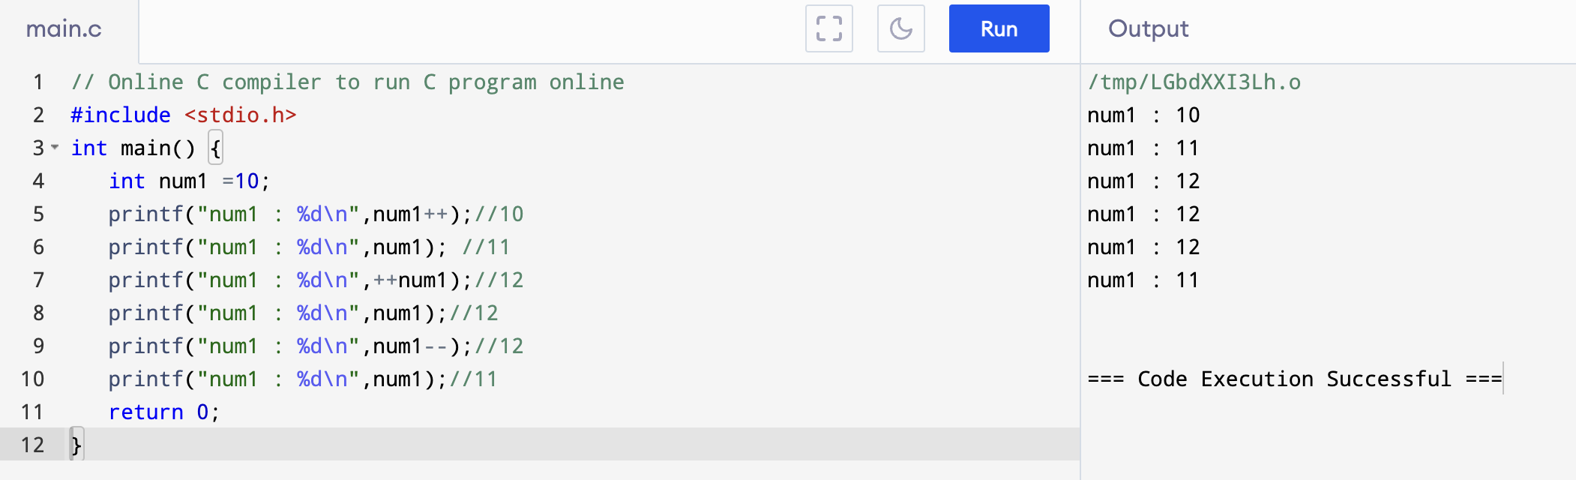
Example

Slide 21
Relational Operators
A relational operator checks the relationship between two operands.
If the relation is true, it returns 1; if the relation is false, it returns value 0.
Relational operators are used in decision making and loops.

Slide 22
Relational Operators
Operator | Meaning of Operator | Example
== | Equal to | 5 == 3 is evaluated to 0
> | Greater than | 5 > 3 is evaluated to 1
< | Less than | 5 < 3 is evaluated to 0
!= | Not equal to | 5 != 3 is evaluated to 1
>= | Greater than or equal to | 5 >= 3 is evaluated to 1
<= | Less than or equal to | 5 <= 3 is evaluated to 0

Slide 23
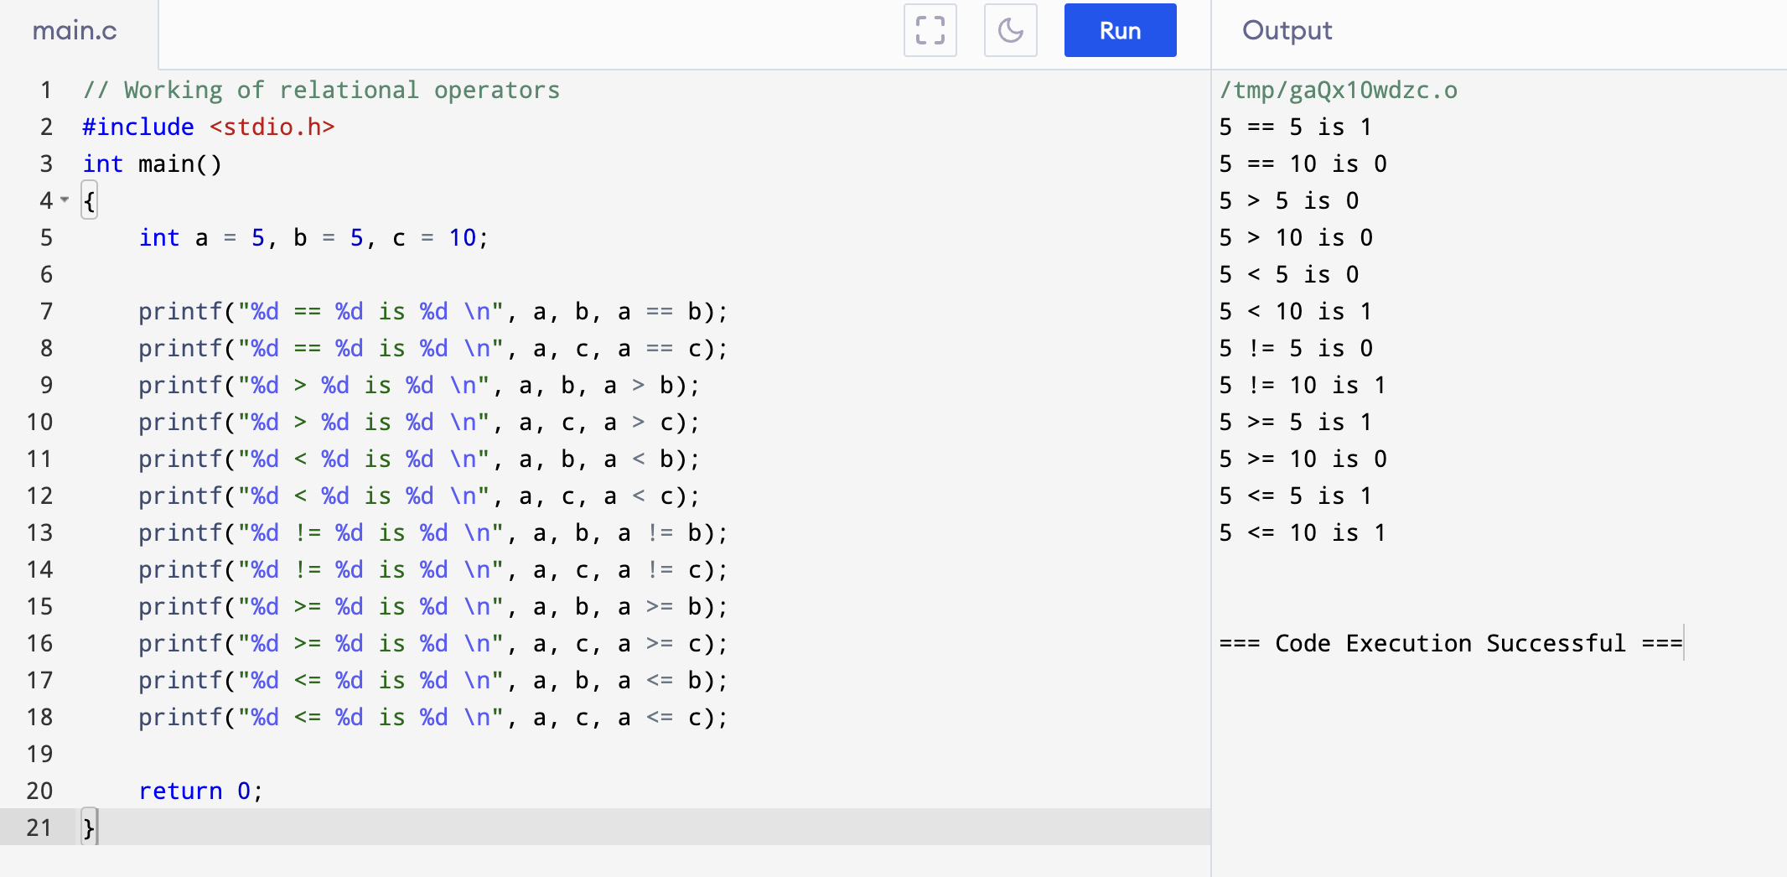
Relational Operators

Slide 24
Logical Operators
An expression containing logical operator returns either 0 or 1 depending upon whether expression results true or false.
Logical operators are commonly used in decision making in C programming.

Slide 25
Logical Operator
Operator | Meaning | Example
&& | Logical AND. True only if all operands are true | If c = 5 and d = 2 then, expression ((c==5) && (d>5)) equals to 0.
|| | Logical OR. True only if either one operand is true | If c = 5 and d = 2 then, expression ((c==5) || (d>5)) equals to 1.
! | Logical NOT. True only if the operand is 0 | If c = 5 then, expression !(c==5) equals to 0.

Slide 26
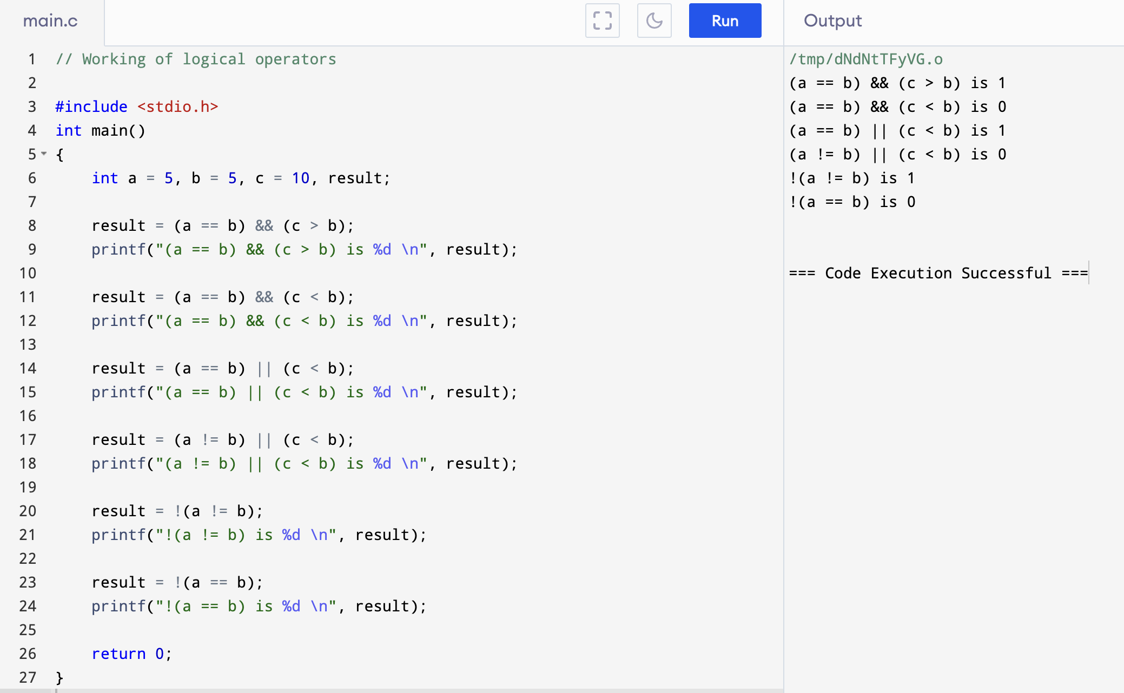

Slide 27
Conditional Operator
The conditional operator is also known as a ternary operator.
It is represented by two symbols, i.e., '?' and ':’.
As conditional operator works on three operands, so it is also known as the ternary operator.
The behavior of the conditional operator is similar to the 'if-else' statement as 'if-else' statement is also a decision-making statement.
Syntax : Expression1? expression2: expression3;

Slide 28
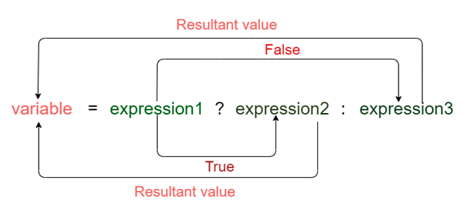
Conditional Operator

Slide 29
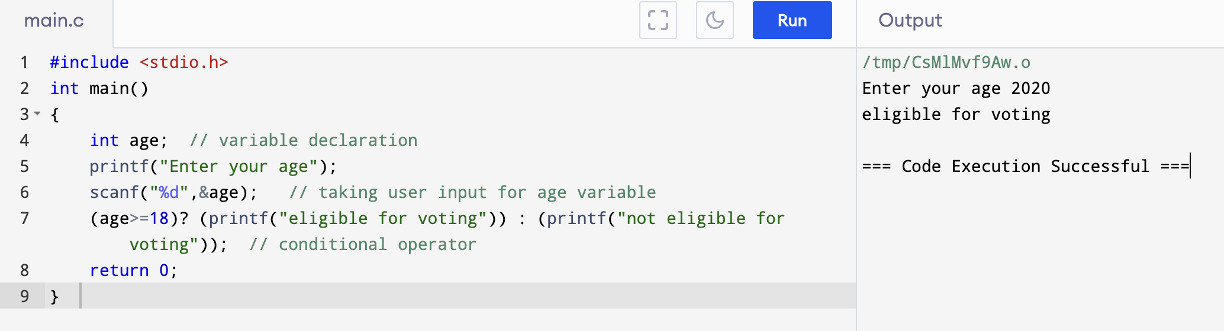
Example

Slide 30
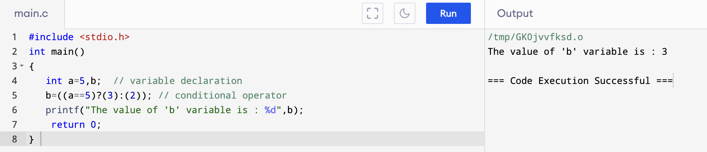
Example

Slide 31
Bitwise Operator
Bitwise operator works with binary data (bit/byte)
With it we can do various logical operations such as AND, OR, NOT, EXOR, Left Shift, Right Shift.
Can only be used on integrals, don’t work with float.

Slide 32
Bitwise Operator
Operators | Meaning of operators
& | Bitwise AND
| | Bitwise OR
^ | Bitwise exclusive OR
~ | Bitwise complement
<< | Left shift
>> | Right shift

Slide 33
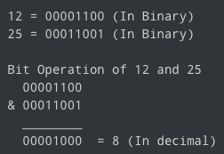
Bitwise AND Operator &
The output of bitwise AND is 1 if the corresponding bits of two operands is 1. If either bit of an operand is 0, the result of corresponding bit is evaluated to 0.

Slide 34
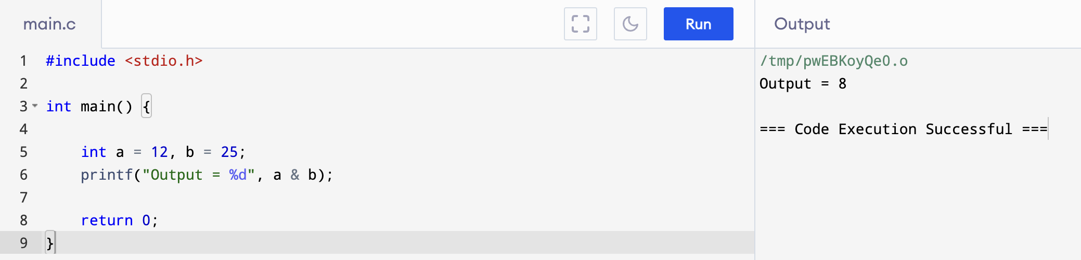
Bitwise AND Operator &

Slide 35
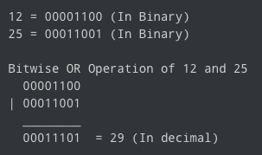
Bitwise OR Operator |
The output of bitwise OR is 1 if at least one corresponding bit of two operands is 1.

Slide 36
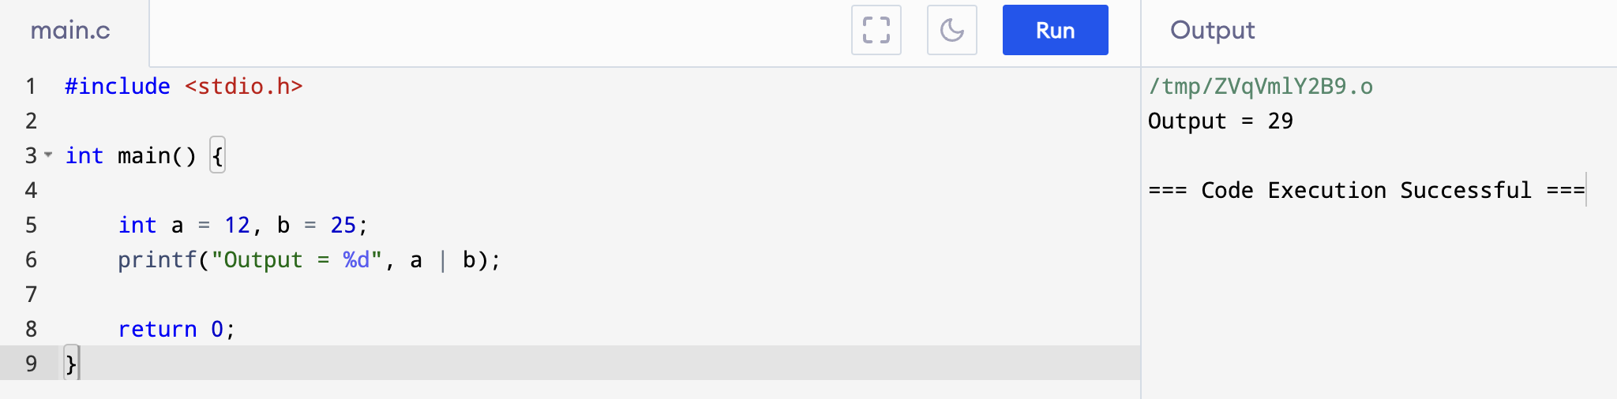
Bitwise OR Operator |

Slide 37
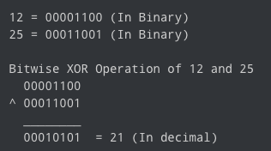
Bitwise XOR (exclusive OR) Operator ^
The result of bitwise XOR operator is 1 if the corresponding bits of two operands are opposite.
It is denoted by ^.

Slide 38
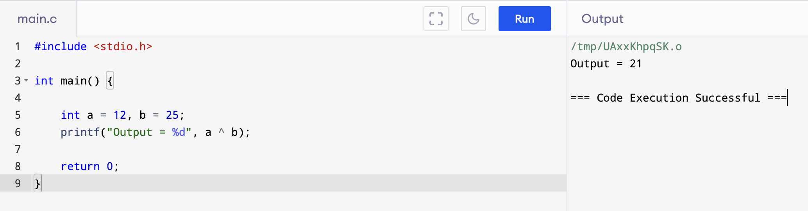
Bitwise XOR (exclusive OR) Operator ^

Slide 39
Bitwise Complement Operator ~
Bitwise complement operator is a unary operator (works on only one operand).
It changes 1 to 0 and 0 to 1.
It is denoted by ~.
For any integer n, bitwise complement of n will be -(n + 1)
35 = 00100011 ( In binary)
~35 = 11011100
00100011
+ 1
00100100 (36)
X = b1
-X = b2
2’s
2’s

Slide 40
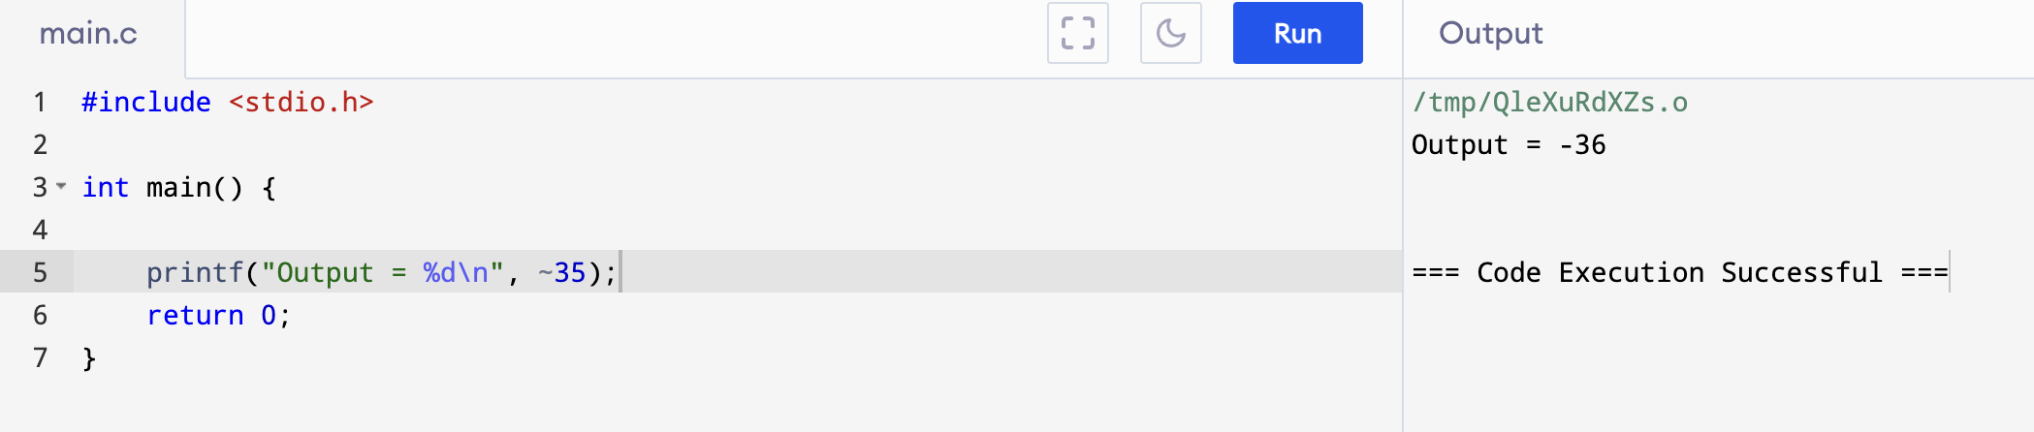
Bitwise Complement Operator ~

Slide 41
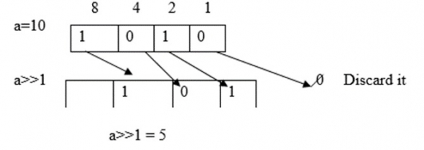
Right Shift Operator
Right shift operator shifts all bits towards right by certain number of specified bits. It is denoted by >>.
If the value of a variable is right shifted one time, then its value becomes half the original value.
For example, a = 10, then a>>1 = 5

Slide 42
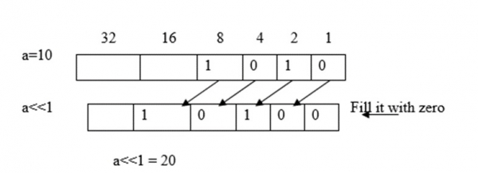
Left Shift Operator
Left shift operator shifts all bits towards left by a certain number of specified bits. It is denoted by <<.
The bit positions that have been vacated by the left shift operator are filled with 0.
If the value is left shifted one time, then its value gets doubled.
For example, a = 10, then a<<1 = 20

Slide 43
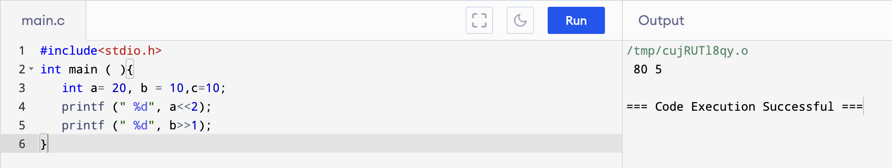
Example

Slide 44
Special Operators
Comma ( , ) − It is used as separator for variables. For example; a=10, b=20
Address (&) − It get the address of a variables.
Size of ( ) − It used to get the size of a data type of a variable in bytes.

Slide 45
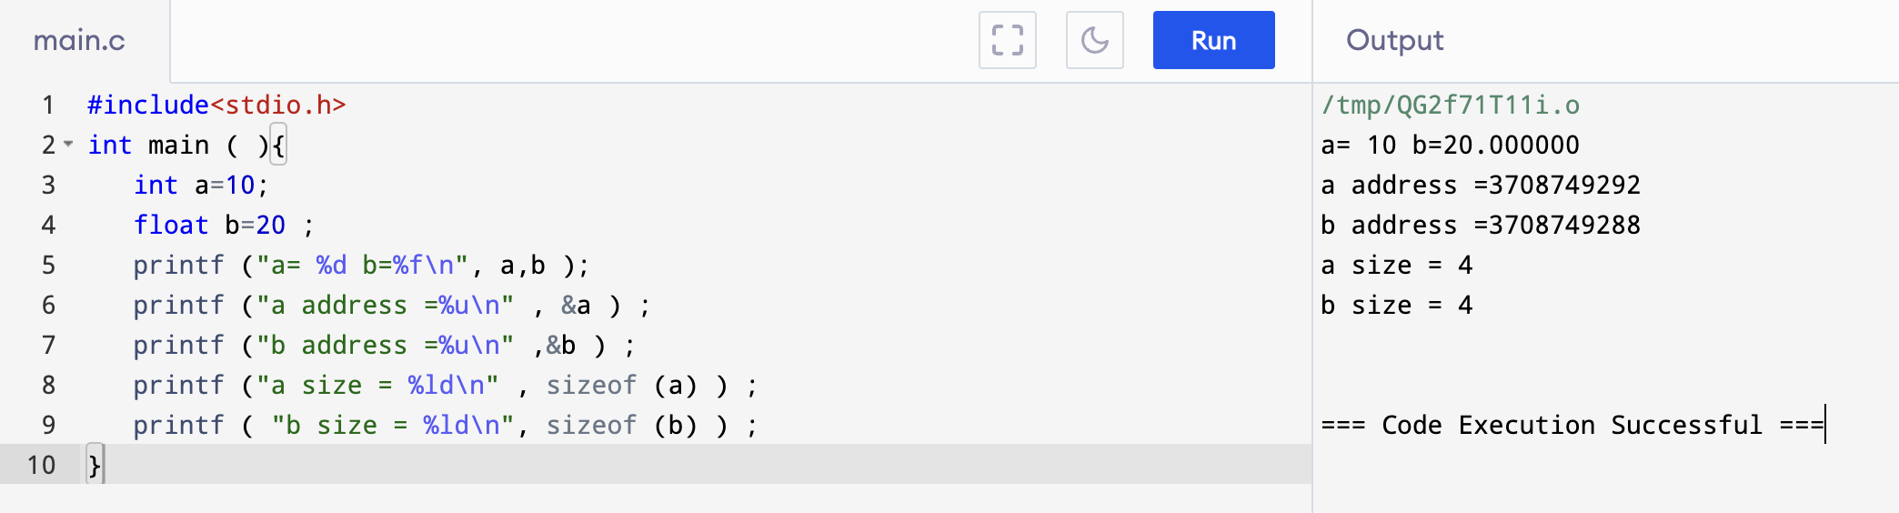
Example

